Slide 1
LOGIC GATES
COMPUTER SYSTEM ARCHITECTURE
BY:
ROSHNI PATOA

Slide 2
WHAT ARE LOGIC GATES?
The building blocks used to create digital circuits are logic gates.
It is a physical device which performs logic operation on one or more logical inputs, and produces a single logical output.
Each gate has its own logic symbol which allows complex functions to be represented by a logic diagram.
The function of each gate can be represented by a truth table or using Boolean notation.

Slide 3
TYPES OF LOGIC GATES:
BASIC GATES:
AND, OR, NOT
UNIVERSAL GATES:
NAND, NOR
ARITHMETIC GATES:
XOR, XNOR
Universal gates have the capability to design every other gates.
Arithmetic gates are used to perform arithmetic operations like addition, subtraction, multiplication, etc. and are generally used in adder, subtractor, multiplexers, etc.

Slide 4
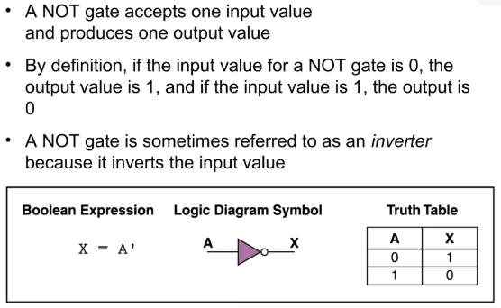
NOT GATE

Slide 5
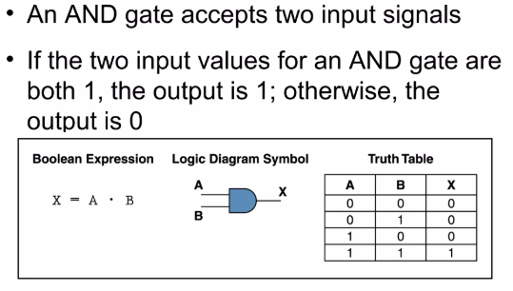
AND GATE

Slide 6
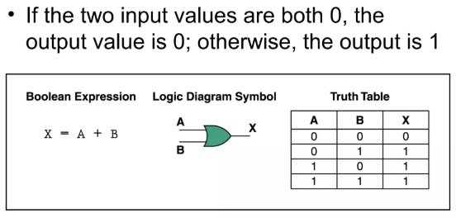
OR GATE

Slide 7
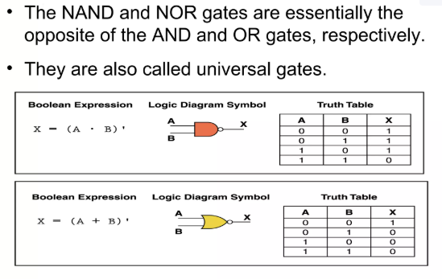
NAND & NOR GATE

Slide 8
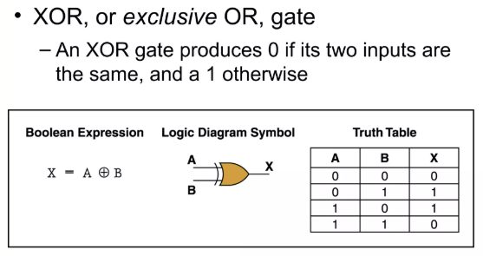
XOR GATE
X = A’.B + A.B’

Slide 9
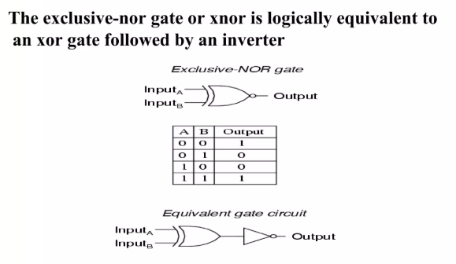
XNOR GATE
OUTPUT = A ⊙ B
OUTPUT = A.B + A’.B’

Slide 10
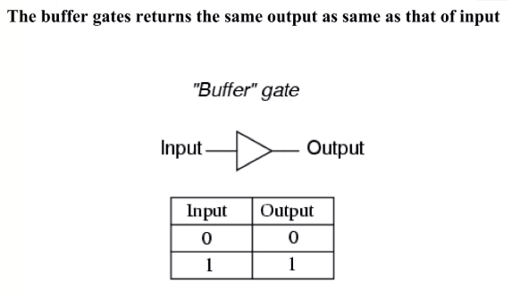
BUFFER GATE

Slide 11
PROPERTIES OF XOR GATE
A ⊕ A = 0
A ⊕ A’ = 1
A ⊕ 1 = A’
A ⊕ 0 = A
6. A ⊕ A ⊕ A ⊕ …….. n times = 0, if n=even
= A, if n=odd

Slide 12
PROPERTIES OF XNOR GATE
A ⊙ A = 1
A ⊙ A’ = 0
A ⊙ 1 = A
A ⊙ 0 = A’
5. A ⊙ A ⊙ A ⊙ …….. n times = 1, if n=even
= A, if n=odd

Slide 13
ADDITIONAL PROPERTIES OF XOR & XNOR GATE
XOR AND XNOR gates are the complements of each other for even number of inputs.
A ⊕ B ⊕ C ⊕ D = (A ⊙ B ⊙ C ⊙ D)’
XOR AND XNOR gates are same for odd number of inputs.
A ⊕ B ⊕ C = A ⊙ B ⊙ C

Slide 14
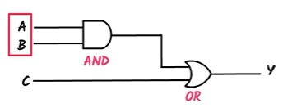
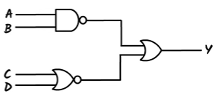
EXERCISES
Write the functions for the logic gates:

Slide 15

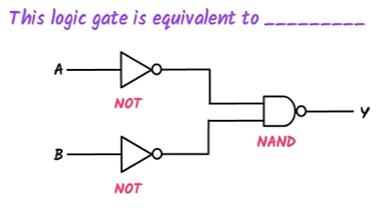
EXERCISES

